Slide 1
Lesson 1.2
The DOM, JS Objects, this Keyword, and Error Handling

Slide 2
Learning Outcomes
Explain what DOM is and how it works
Use this keyword in your code
Describe objects and its use in JS
Create different types of objects
Write code to access and use object values
Use error handling techniques

Slide 3
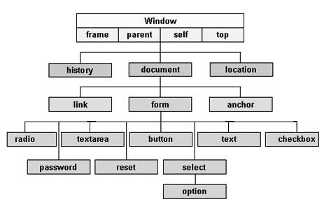
Document Object Model (DOM)
When a webpage is loaded, the browser creates a Document Object Model (DOM) of the page.
The DOM represents a document with a logical tree.
Each branch ends in a node.
Each node contains objects.
The DOM connects web pages to JavaScript by representing the structure of a document in memory.
Each element on a webpage is represented in the DOM.
This makes it possible for a JavaScript program to access individual elements.

Slide 4
Document Object Model (DOM)
The DOM has built-in methods to access each object.
Use the document interface to access the DOM.
Ways to access HTML elements:
document.getElementById()
document.getElementsByClassName()
document.getElementsByName()
Ways to display JavaScript data
innerHTML
Display data by changing this property of an HTML element.
Example: document.getElementById("demo").innerHTML = “Hello World”;
document.write()
Overwrites all existing HTML with the new HTML. Useful for testing purposes
Example: document.write(“Hello World”);
Example: https://codepen.io/michael-dorsey/pen/QWXLMgG

Slide 5
Objects
JavaScript is an “object-based” language.
In JavaScript, everything is an object (except for language constructs, keywords and operators).
An object is an unordered collection of data.
Data can be primitive types, functions and even other objects.
Objects have properties. Properties have values.
Written as name:value pairs → [Property name]:[Property value]
Properties are like nouns and adjectives.
Objects have methods. Methods are actions that can be performed on objects.
Methods are functions stored as properties.
Methods are like verbs.
JavaScript objects are dynamic – properties can be added and deleted at any time.
Use the dot (.) operator to access property values.
The dot operator means "find the item with this name and return the associated value".

Slide 6
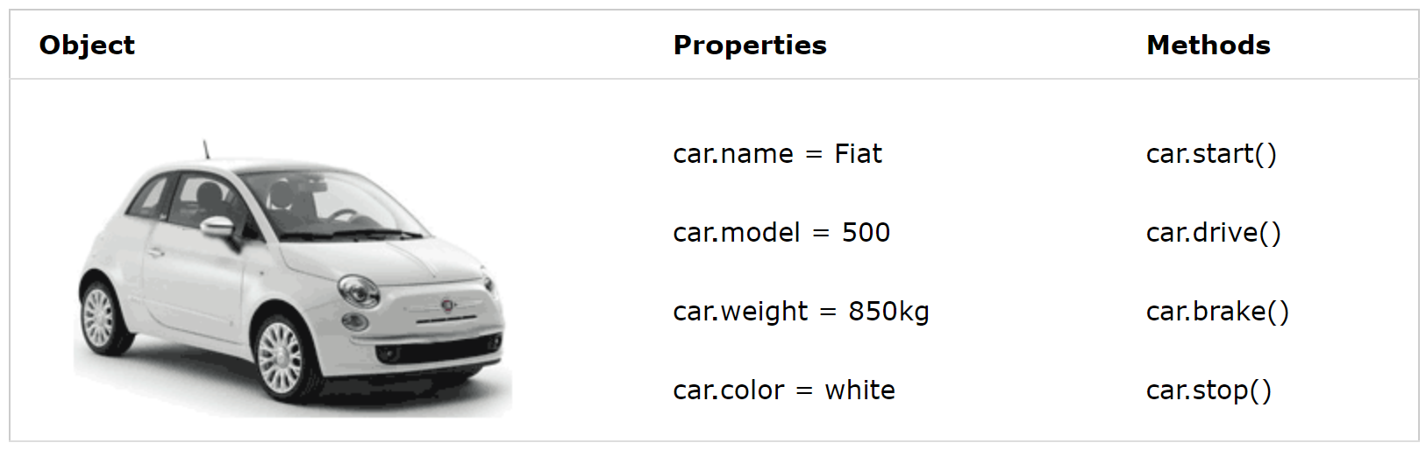
Objects

Slide 7
Types of Objects
User-defined
Custom objects created by a programmer.
Can be nested within other objects. This allows you to create complex or composite data structures consisting of data and methods.
Native objects
Objects associated with data types such as string, number, Boolean, etc.
These are governed by the ECMAScript language standard.
Host objects
Includes the window, navigator, XMLHTTPRequest, location, history, etc.
Document objects
Objects that are part of the DOM.
Defined by the W3C.

Slide 8
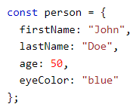
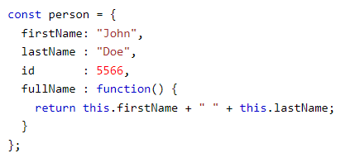
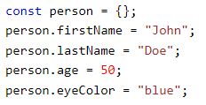
Ways to create an object: Object Literal
Notes:
The easiest way to create a JavaScript Object is using an object literal.

Slide 9
Ways to create an object: Constructors
Sometimes we need to create multiple objects that have the same “blueprint”.
To do that we can use an object constructor function.
Objects of the same type can be created by calling the constructor function with the new keyword.
Best practice is to name constructor functions with an upper-case first letter.
Example: function Person(…) {}
Example: function Car(…) {}
Important notes:
The this operator is used in the constructor function to refer to the object itself.
There is no return statement in a constructor function.
Example: https://codepen.io/michael-dorsey/pen/bGZqMrZ

Slide 10
this keyword
In JavaScript, the this keyword refers to the current object.
It is not a variable; it is a keyword. You cannot change the value of this.
It allows access to the object’s properties and attributes from within an object method, function or event.
The this keyword refers to different objects depending on how it is used:
In an object method, this refers to the current object.
Alone or in a function, this refers to the global object.
In a function in strict mode, this is undefined.
In an event, this refers to the element that received the event.
Methods like call(), apply(), and bind() can refer this to any object.
What is “strict” mode?
Strict mode is a way to opt-in to a restricted variant of JavaScript.
It eliminates some JavaScript silent errors by changing them to throw errors.
Fixes mistakes that make it difficult for JavaScript engines to perform optimizations
Prohibits some syntax likely to be defined in future versions of ECMAScript.

Slide 11
Error Handling
There are three general types of errors in programming.
1) Syntax errors: mistakes in the code structure.
Examples: spelling mistakes, forgetting to close a bracket { }.
2) Runtime errors: mistakes that occur while the program is running.
Examples: divide by 0, infinite loops.
3) Logical errors: mistakes in the logic of the code.
Example: program behaving unexpectedly, program not producing the correct output.
We can use error handling to find, catch, and handle problems with code.
Conditional statements (if/else) can also be used to control errors.

Slide 12
Error Handling
Four keywords to implement error handling:
try
Defines a code block to run (to try).
catch
Defines a code block to “catch” an error in the try statement and handle it appropriately.
finally
Defines a code block to run regardless of whether there was an error in the try statement or not.
throw
Defines a custom error that should be “thrown” to a catch statement.

Slide 13
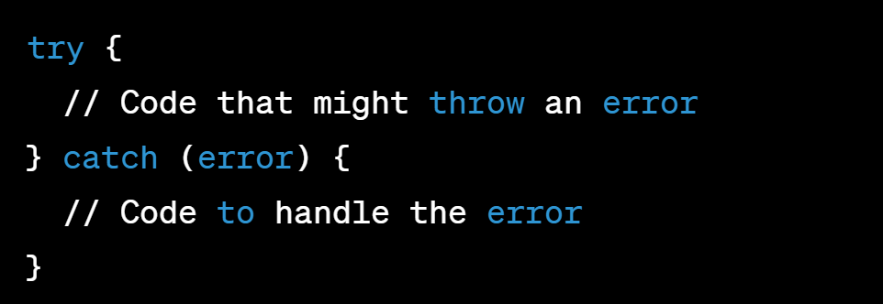
try and catch
try and catch come in pairs.
The catch block will only be executed if an error occurs in the try block.

Slide 14
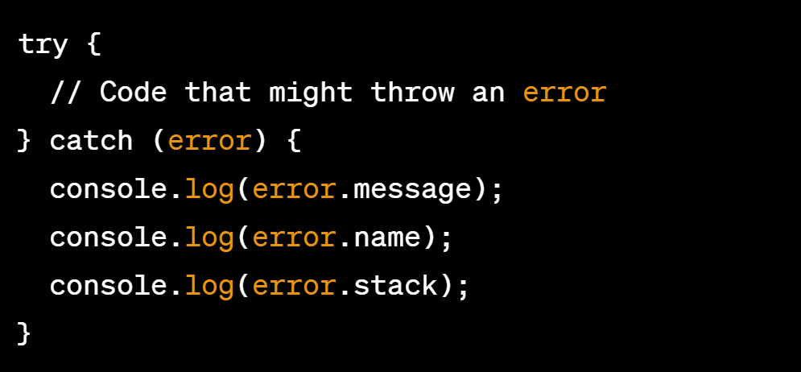
throw an exception
When an error occurs, JavaScript will stop and generate an “error” object.
Known as “throw an exception” or “throw an error”.
The error object can be viewed to help diagnose the problem.
error.message
error.name
error.stack
View types of errors: https://www.w3schools.com/js/js_errors.asp

Slide 15
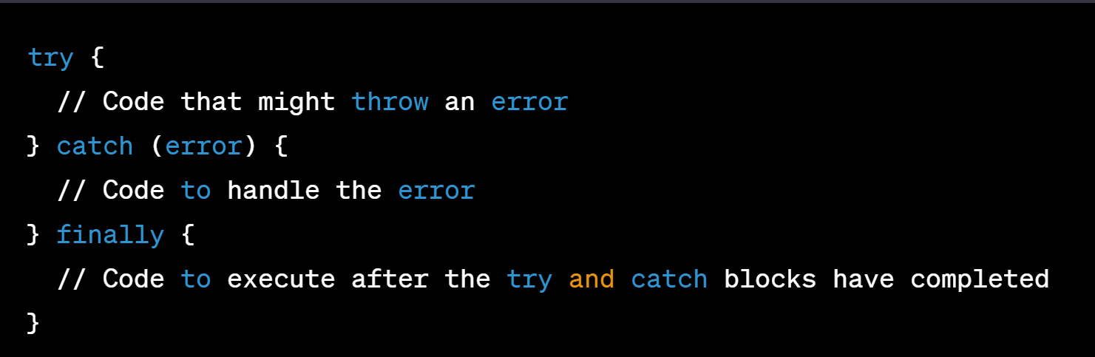
finally
The finally statement lets you execute code, after try and catch, regardless of the result.
It allows programmers to define actions that must be performed regardless of the outcome.
Examples: clean up memory, properly store data, send a message to the user.

Slide 16
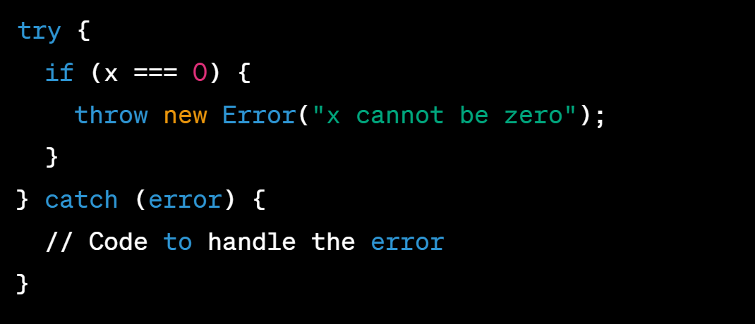
throw
The throw statement allows you to create a custom error, usually based on your program’s business rules.
Example: a user tries to create a username that has already been taken.
The exception can be a string, number, Boolean or an object.

Slide 17
Error Handling
Examples:
https://codepen.io/michael-dorsey/pen/NWJpMOQ
https://codepen.io/michael-dorsey/pen/KKjPveq

Slide 18
Practice Activity
Create an object constructor function for a “Car” object.
A Car object has the following properties:
Make (example: Honda)
Model (example: Civic)
Year (example: 2024)
A Car object has a method called displayDetails that returns the make, model and year in a string.
Use a try/catch block to check if the year is a number and greater than 0. Throw an error if it is not.
Starter code: https://codepen.io/michael-dorsey/pen/gONOzdY

Slide 19
References
https://www.w3schools.com/js/js_htmldom.asp
https://www.w3schools.com/js/js_this.asp
https://www.w3schools.com/js/js_objects.asp
https://www.w3schools.com/js/js_errors.asp

Slide 20
Lesson 1.3
JS Functions and Arrow Function Syntax

Slide 21
Learning Outcomes
Use different function writing techniques
Use arrow function syntax
Use invoking function and function callback
Create simple to complex functions using all the different function writing techniques
Create different interactive web applications

Slide 22
JavaScript Functions
A JavaScript function is a block of code designed to perform a particular task.
It is executed when something invokes it (calls it).
It is defined once but invoked many times.
Can use the same code with different arguments to produce different results.
Can be used to return a value, construct an object, or just run any block of code.

Slide 23

JavaScript Function Syntax
Defined with the function keyword and a unique name.
Parentheses ( ) may include parameter names separated by commas.
The code to be executed is placed inside { }.
Function arguments are the values received by the function when it is invoked.
When JavaScript reaches a return statement, the function will stop executing and return to where it came from.
Best practice: design your functions to have only 1 return statement. Why?

Slide 24
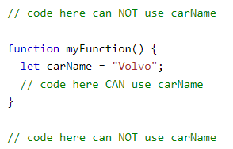
Function Scope
Variables declared within a JavaScript function are local to the function.
Local variables have function scope, which means that they can only be accessed from within the function.
Local variables are created when a function begins, and destroyed when the function is completed.
Each function creates a new scope.
Therefore, variables with the same name can be used in different functions.

Slide 25
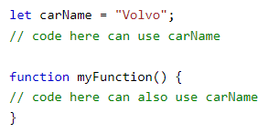
Global Scope
A variable declared outside a function becomes global.
A global variable has global scope which means that all scripts and functions on a web page can access it.
In a web browser, global variables are destroyed when you close the browser window/tab.

Slide 26
Types of Functions
Function declaration
Function expression
Self-Invoking function
Anonymous function
Functions with parameters
Functions with default values
Arrow function
Callbacks
Recursive

Slide 27

Function Declaration
Declared functions are not executed immediately.
They will be executed later when they are invoked.
A semicolon (;) is not required after a function declaration since it is not an executable statement.

Slide 28

Function Expression
A JavaScript function can also be defined using an expression.
A function expression can be stored in a variable. The variable can then be used as a function.
A function expression needs a semicolon (;) because it is part of an executable statement.
Best practice: store function expressions in a const variable.

Slide 29

Self-Invoking Functions
Function expressions can be made self-invoking (also called an immediately invoked function). This means that the function is invoked (started) automatically, without being called.
You cannot self-invoke a function declaration.
You must add parentheses () around the function to indicate that it is a function expression.
Function expressions will execute automatically if the expression is followed by parentheses ().
Useful for initialization tasks such as attaching event listeners to DOM elements.
Example: https://codepen.io/michael-dorsey/pen/eYwOELM

Slide 30

Anonymous Functions
An anonymous function is a function that does not have any name associated with it.
Functions stored in variables are anonymous functions. They do not need names as they are invoked using the variable name.
Self-invoking functions can be anonymous.
You can pass anonymous functions as parameters into another function.

Slide 31
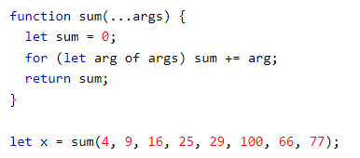
Functions with Parameters
Parameter rules:
Data types for parameters are not specified.
Functions do not perform type checking on the passed arguments.
Functions do not check the number of arguments received.
If a function is called with missing arguments, the missing values are set to undefined.
The rest parameter (...) allows a function to treat an indefinite number of arguments as an array.

Slide 32
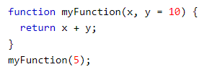
Functions with Default Values
Function parameters can have default values.
If a parameter is not passed to a function, it can have a predetermined value and therefore not be undefined.

Slide 33
Arrow Functions
An arrow function expression is a compact alternative to a traditional function expression.
It makes our code more concise and simplifies function scoping and the this keyword.
Arrow functions are useful where you need to write a small function which is executed somewhere else.
Arrow functions use an arrow: =>
Everything before the arrow are arguments.
Everything after the arrow is always returned as the result of the function.
Arrow functions are always anonymous.
If the arrow function needs to call itself, use a named function expression instead.
You can also assign the arrow function to a variable, so it has a name.
Restrictions on arrow functions:
Arrow functions do not have their own this. They are not well suited for defining object methods.
Arrow functions are not hoisted. They must be defined before they are used.
Cannot be used as constructors.

Slide 34
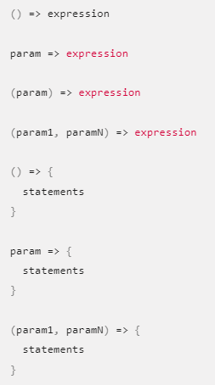
Arrow Function Syntax
Parentheses () can be omitted if the function has 1 parameter.
Parentheses () are required for 0 or multiple parameters.
Braces {} and the return keyword can be omitted if the function directly returns an expression.
Braces {} are required if there are multiple statements.
The return keyword is required if there are multiple statements.
Arrow functions cannot guess what or when you want to return.

Slide 35
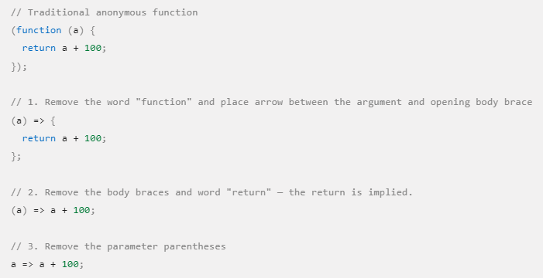
How to convert a traditional function to an arrow function.

Slide 36
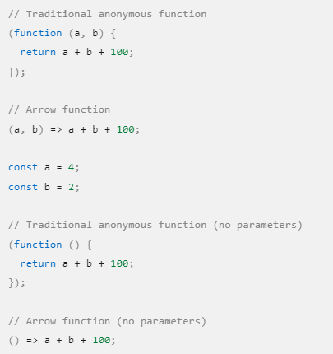
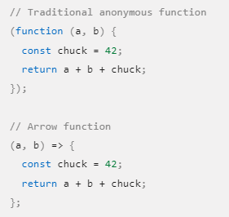
Parentheses () can only be omitted if the function has a single simple parameter. If it has multiple parameters or no parameters, the parentheses around the parameter list are required.
Braces {} can only be omitted if the function directly returns an expression. If the body has additional lines of processing, the braces are required.
The return keyword can only be omitted if the function directly returns an expression. If the body has additional lines of processing, the return keyword is required.

Slide 37
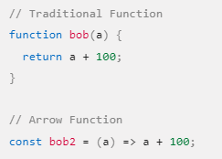
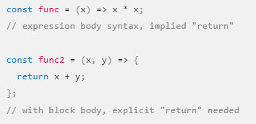
Arrow functions are always unnamed. If the arrow function needs to call itself, use a named function expression instead.
Arrow functions can have either an expression body or the usual block body. In an expression body, only a single expression is specified, which becomes the implicit return value. In a block body, you must use an explicit return statement.

Slide 38
Callbacks
A callback is a function passed as an argument to another function. This technique allows a function to call another function.
When you pass a function as an argument, remember not to use parenthesis ().
Why do we use callbacks?
JavaScript runs code sequentially in top-down order. However, there are some cases that code must run after something else happens and not sequentially. This is called asynchronous programming.
Callbacks make sure that a function is not going to run before a task is completed but will run right after the task has completed.
Examples: waiting for a file to load; waiting for a response from an external server.

Slide 39
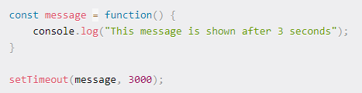

Callbacks

Slide 40

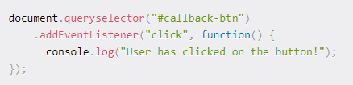
Callbacks
Example: https://codepen.io/michael-dorsey/pen/wvOdZBy

Slide 41
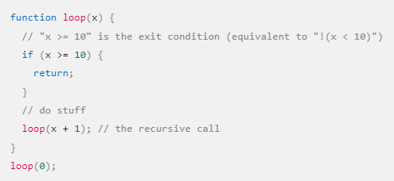
Recursive Functions
A function that calls itself is called a recursive function.
Recursion is analogous to a loop.
Execute the same code multiple times.
Requires a condition to avoid an infinite recursion.
Why use recursion?
Can help break down a problem into smaller, similar sub-problems
Example: https://codepen.io/michael-dorsey/pen/poYrzLg

Slide 42
Practice Activity
Starter code: https://codepen.io/michael-dorsey/pen/YzoKxBK
Convert each of the 5 given functions into an arrow-style function.

Slide 43
Assessments
Quiz 1
Worth 10% of your grade.
Take it at-home, at your convenience.
Covers Module 1: Lessons 1 and 2.
35-minute time limit.
25 multiple-choice and multi-select questions.
Due by July 16, 8:00am.

Slide 44
For next class
Do Learning Activity 1.3.3.
Read Lesson 1.4 and do Learning Activities 1.4.1.
Declare any preferences for members of your group project by July 9 (max 3 people in a group).
Assessments Reminder:
Quiz 1 due July 16, 8:00am.
All assessment dates have been posted in D2L.
See the “Assignments Policy” for late submission procedures.

Slide 45
References
https://www.w3schools.com/js/js_callback.asp
https://www.w3schools.com/js/js_functions.asp
https://www.w3schools.com/js/js_scope.asp
https://www.edureka.co/blog/advanced-javascript-tutorial/#functions
https://developer.mozilla.org/en-US/docs/Web/JavaScript/Reference/Functions/Arrow_functions
https://www.w3schools.com/js/js_function_definition.asp
https://www.geeksforgeeks.org/javascript-anonymous-functions/
https://www.w3schools.com/js/js_function_parameters.asp
https://www.freecodecamp.org/news/javascript-callback-functions-what-are-callbacks-in-js-and-how-to-use-them/

